Slide 1
Developing Hispanic-Serving
Institutions (DHSI) Program
Technical Assistance for Grantees
Njeri Clark, DHSI Program Lead
and Competition Manager

Slide 2
Today’s Agenda
Overview of the HSI Division
Overview of the DHSI Program
Allowable Activities
Role of the Project Director
Project Director Resources
Project Director Challenges
Considerations for the Project Director
FAQs
Helpful Tips for Project Directors
Questions from the Audience

Slide 3
Overview of the Hispanic-Serving Institutions (HSI) Division
This Photo by Unknown Author is licensed under CC BY

Slide 4
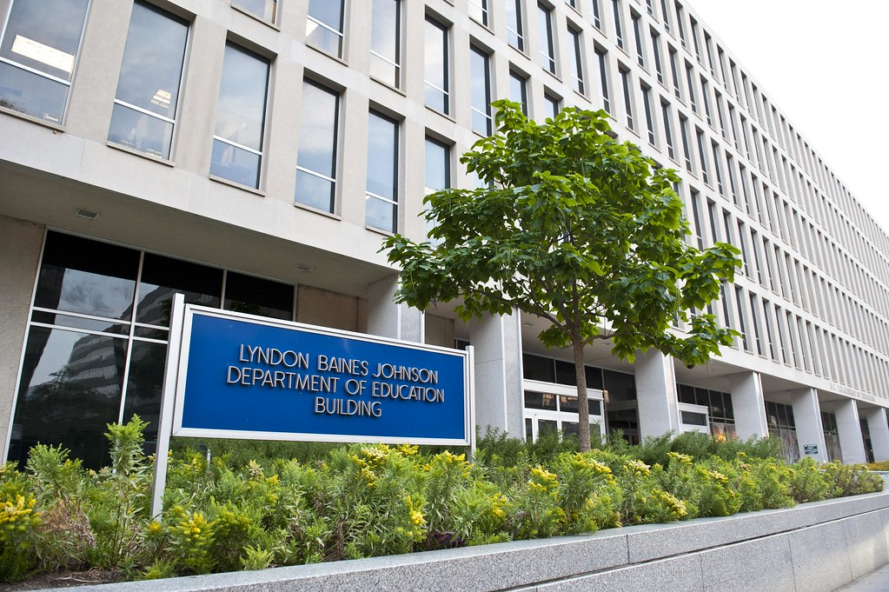
The Hispanic-Serving Institutions Division is a division within one of the many principal offices within the U.S. Department of Education. We are located at Washington, DC headquarters-LBJ Building. Our division is comprised of 6 team members and the Division Director, Stacey Slijepcevic.
Our 6 team members serve as Program Officers who manage a comprehensive grant portfolio based on locale. Our grantees have grants under one or more of the following programs: Developing Hispanic-Serving Institutions (DHSI), Promoting Post-baccalaureate Opportunities for Hispanic Americans (PPOHA), Hispanic-Serving Institutions STEM and Articulation (HSI STEM), and various FIPSE programs.
Our mission is to support Institutions of Higher Education that are educating the majority of Hispanic college students in America.

Slide 5
Hispanic-Serving Institutions Division Dr. Stacey Slijepcevic, Division Director Stacey.slijepcevic@ed.gov 202-453-6150
Njeri Clark
Njeri.clark@ed.gov
202-453-6224
Kurrinn Cusumano-Abrams
Kurrinn.abrams2@ed.gov
202-453-7906
Dr. Robin M. Dabney
Robin.dabney@ed.gov
202-453-7908
Richard (Rick) Gaona
Richard.Gaona@ed.gov
202-453-6077
Margarita Melendez
Margarita.melendez@ed.gov
202-260-3548
Jymece Seward
Jymece.seward@ed.gov
202-453-6138

Slide 6
Common Acronyms used at ED
GAN (Grant Award Notification)
APR (Annual Performance Report)
IPR (Interim Performance Report)
OMB (Office of Management and Budget)
NCC (Non-Competing Continuation)
EDGAR (Education General Administrative Regulations)
PD (Project Director)
PO/PS (Program Officer or Program Specialist)
DoEd or ED (U.S. Department of Education)
DHSI or Title V, Part A (Developing Hispanic-Serving Institutions Program)
PPOHA or Title V, Part B (Promoting Post-baccalaureate Opportunities for Hispanic Americans Program)
HSI STEM and Articulation or Title III, Part F (Hispanic-Serving Institutions Science, Technology, Engineering and Math and Articulation Program)
FIPSE(Fund for the Improvement of Postsecondary Education)-various programs like Basic Needs, Modeling and Simulation, Gang-related Youth, etc.

Slide 7
Overview of the DHSI Program

Slide 8
Purpose of the DHSI program
To assist HSIs in expanding educational opportunities for,
and improving the academic attainment of, Hispanic and low-income
students.
DHSI Program grants also expand and enhance
the academic offering, program quality,
and institutional stability of colleges
and universities that are educating
the majority of Hispanic college
students and helping large numbers
of Hispanic students and low-income
individuals complete postsecondary
degrees.

Slide 9
Allowable Activities

Slide 10
What’s allowed
Student Support Services
Curriculum Development
Construction/Renovation
Equipment purchases
Online course development
Peer Mentoring/tutoring
Faculty development
Project evaluation
Endowment funds
Outreach activities
Stipends to students and staff
Student and staff travel associated with project
Costs related to meetings or conferences that are associated with the project (i.e food, speaker fees, etc.)
Furnishing student centers, labs, etc.
Membership and subscription fees
Other activities, if approved

Slide 11
What’s not allowed…
Indirect costs
Alcohol purchases
Cost of extra-curricular activities unless tied directly to the grant
Payment of salaries for officials with college-wide administrative authority
Activities not approved in the proposal unless prior approval is received by the ED PS.
If you have questionable costs, seek approval from your ED Program Officer. The expense may be approved if it is allowable under the funded program and directly relates to an objective of the grant.

Slide 12
The Role of the Project Director

Slide 13
The Role of the Project Director Note: Certifying Official and PD cannot be the same person.
Submits any information requested from the Department of Education in a timely manner
Creates Internal Controls Manual for the grant
Ensures grant staff is trained on grant legislation, regulations, procedures, etc.
Cooperates with Program Officer during site visits
Ensures evaluation methods are sound and produce results
Actively works to institutionalize components of the project
Oversees the project and staff to ensure successful implementation of activities
Communicates often with Program Officer
Seeks guidance from Program Officer regarding allowable activities, questionable costs, budget modifications, key personnel, regulations, procedures, etc
Ensures project stays within budget and is compliant at all times.
Communicates with Budget/Finance office within his or her institution to ensure financial coordination and compliance

Slide 14
Project Director Resources
1. Regulations
2. OMB Uniform Guidance -2CFR 200
3. Grantee Handbook
4. Program Website
5. GAN attachments
6. HSI Newsletter
7. Grantee Training Webinars

Slide 15
Regulations

Slide 16
Compliance
a. Program Statutes
b. EDGAR- 34 CFR Parts 75, 77, 79, 82, 84, 86, 97, 98, and 99
c. EDGAR- 34 CFR Part 606
d. The OMB Guidelines to Agencies on Government-wide Debarment and Suspension- 2CFR 180, as adopted and amended in 2 CFR part 3474.
e. The Uniform Administrative Requirements, Cost Principles, and Audit Requirements for Federal Awards in 2 CFR part 200, as adopted and amended in 2 CFR part 3474. Uniform Guidance

Slide 17
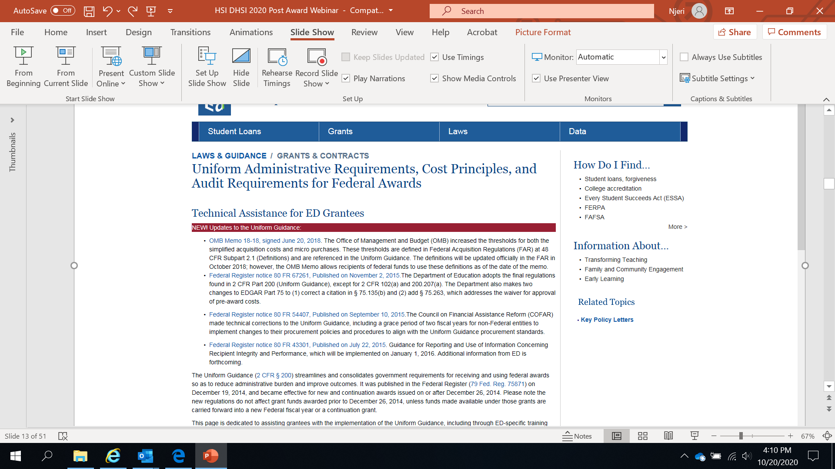
Uniform Guidance

Slide 18
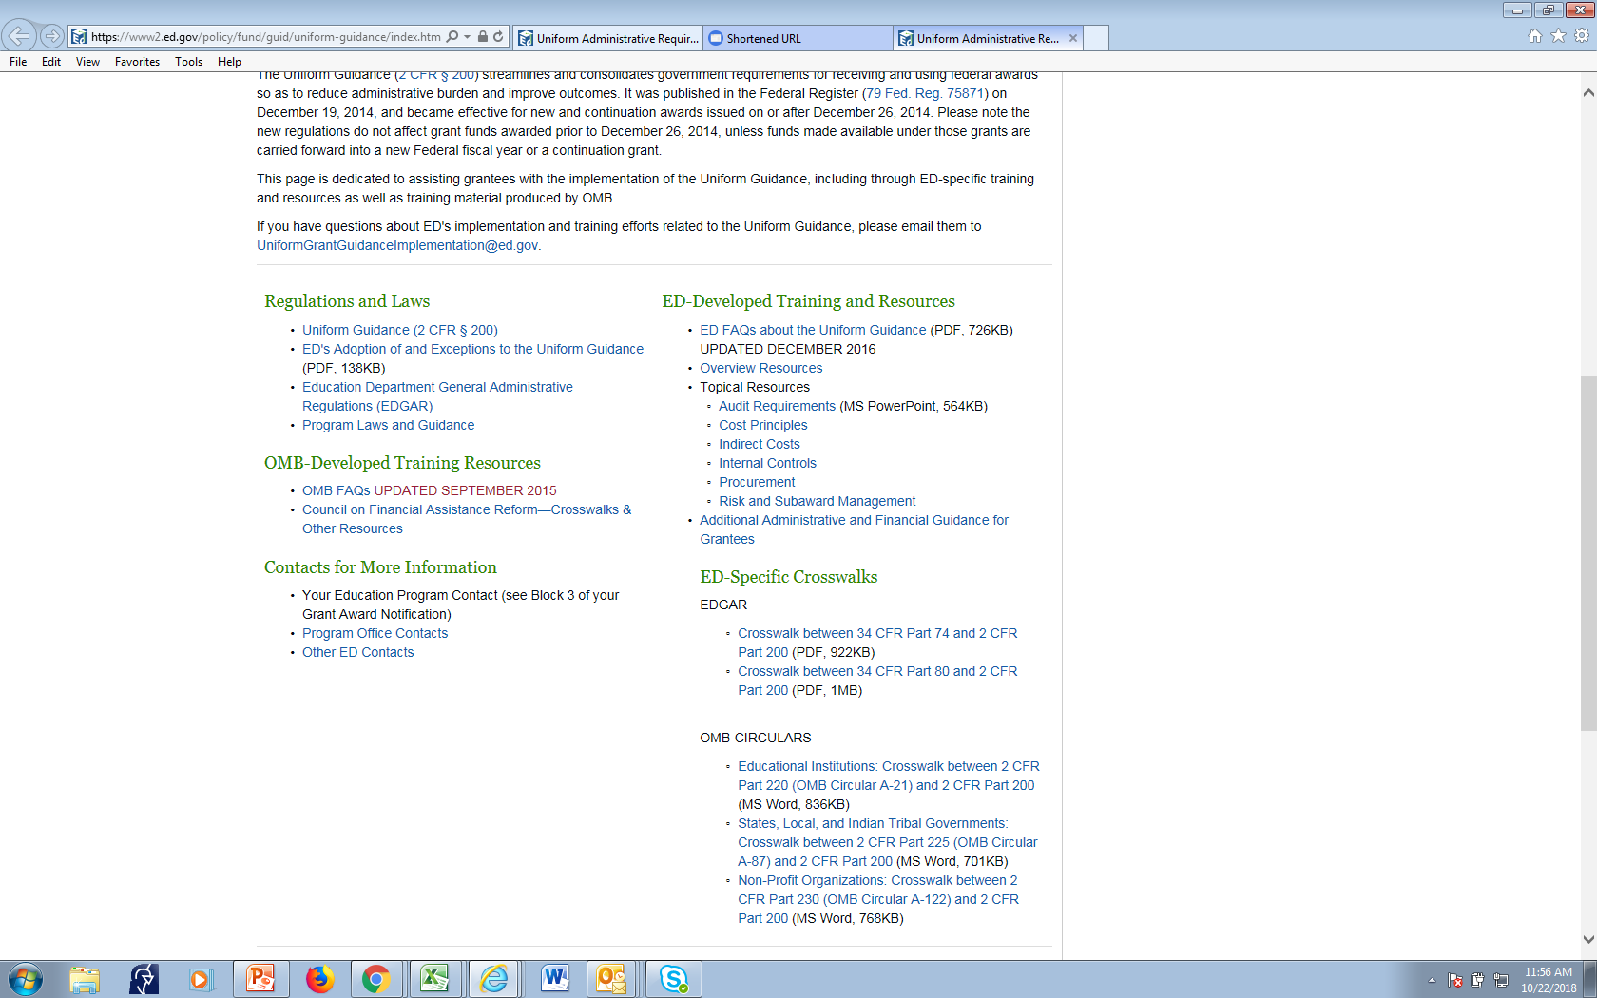
Uniform Guidance Website

Slide 19
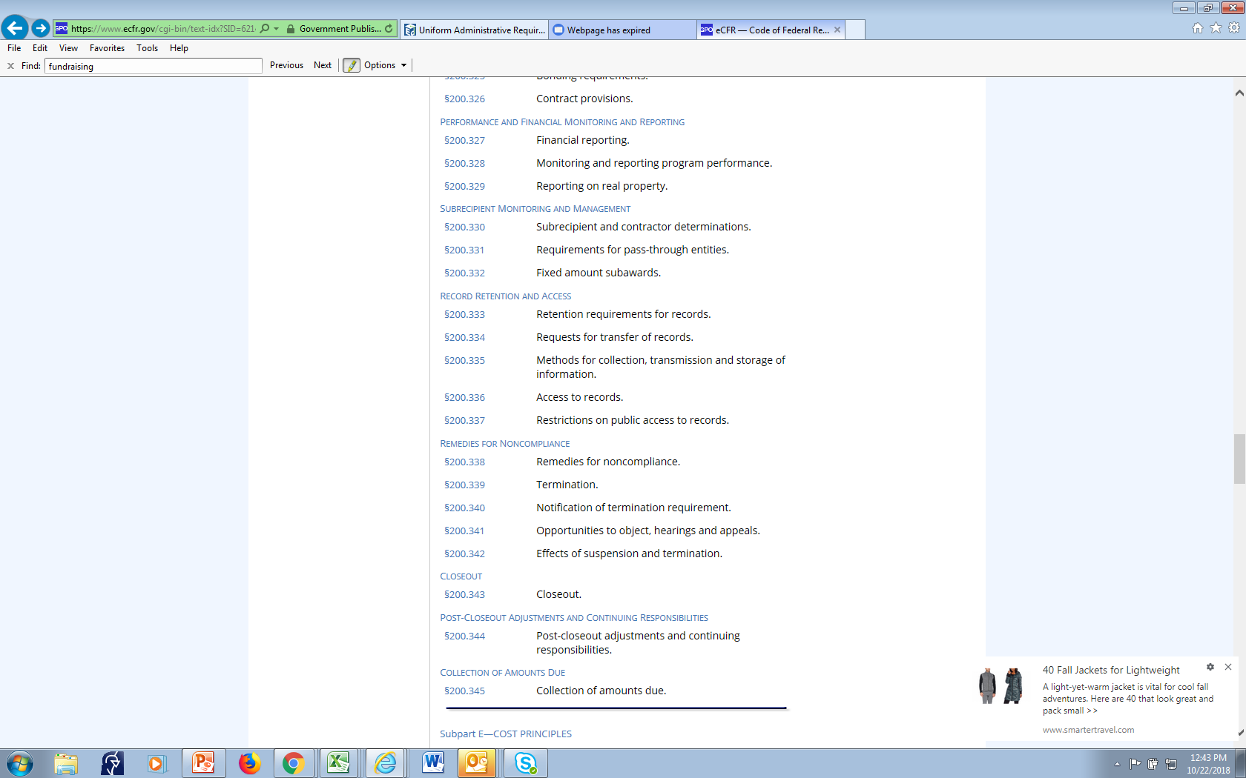
Cost Principles

Slide 20
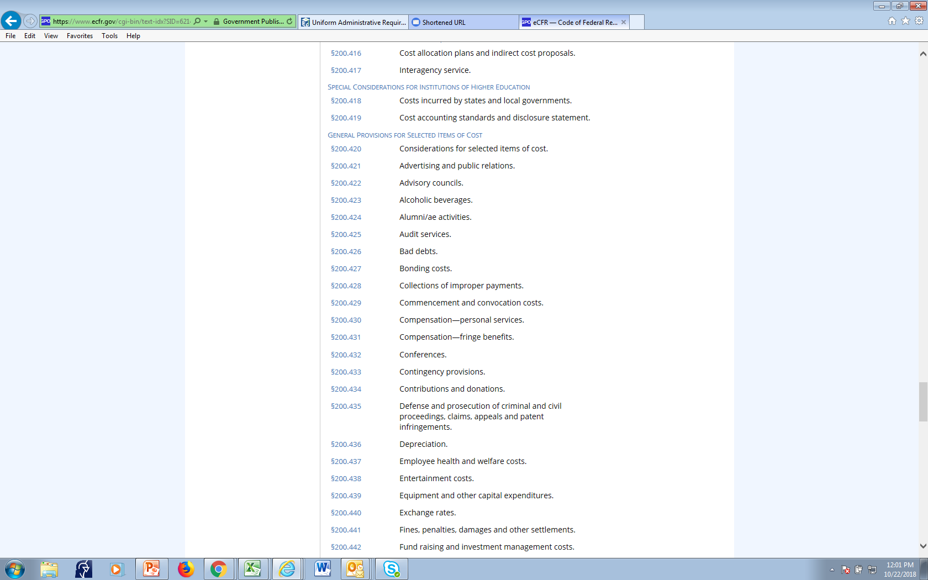
20

Slide 21
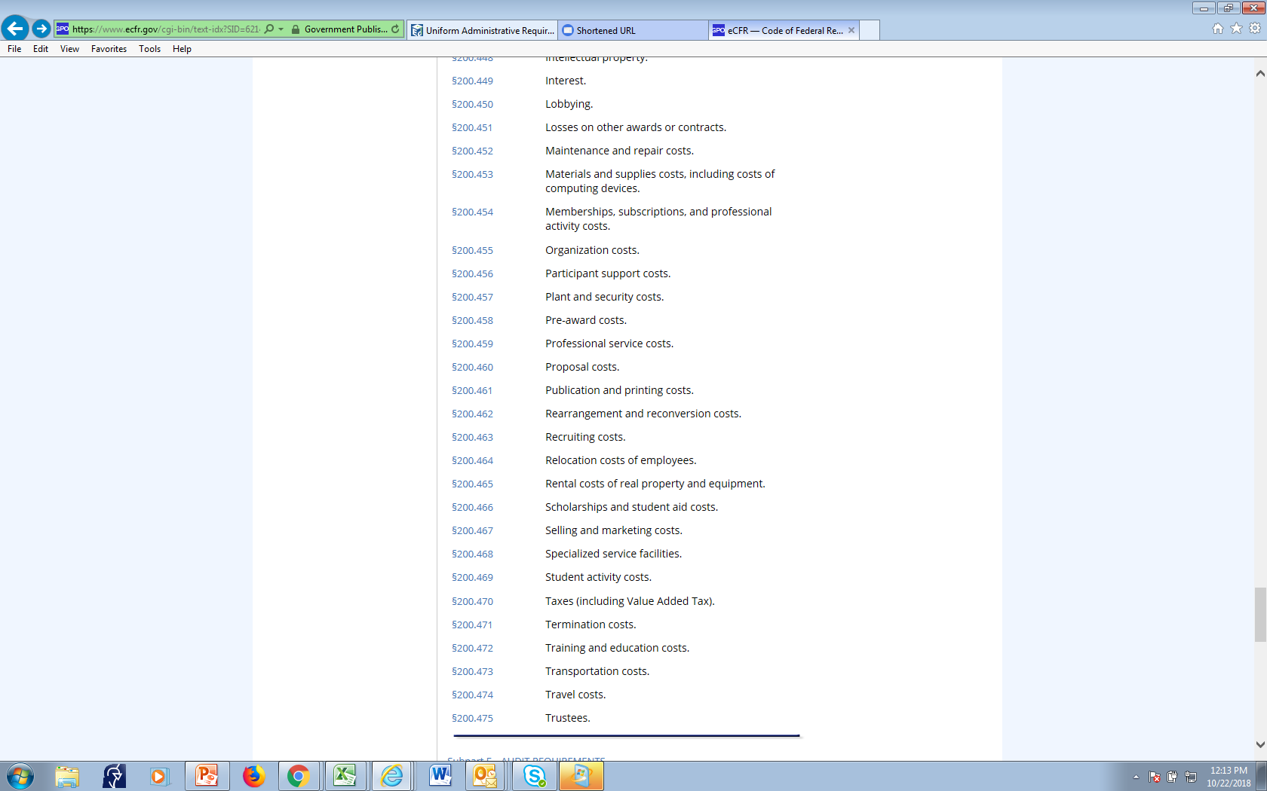
Cost Principles

Slide 22
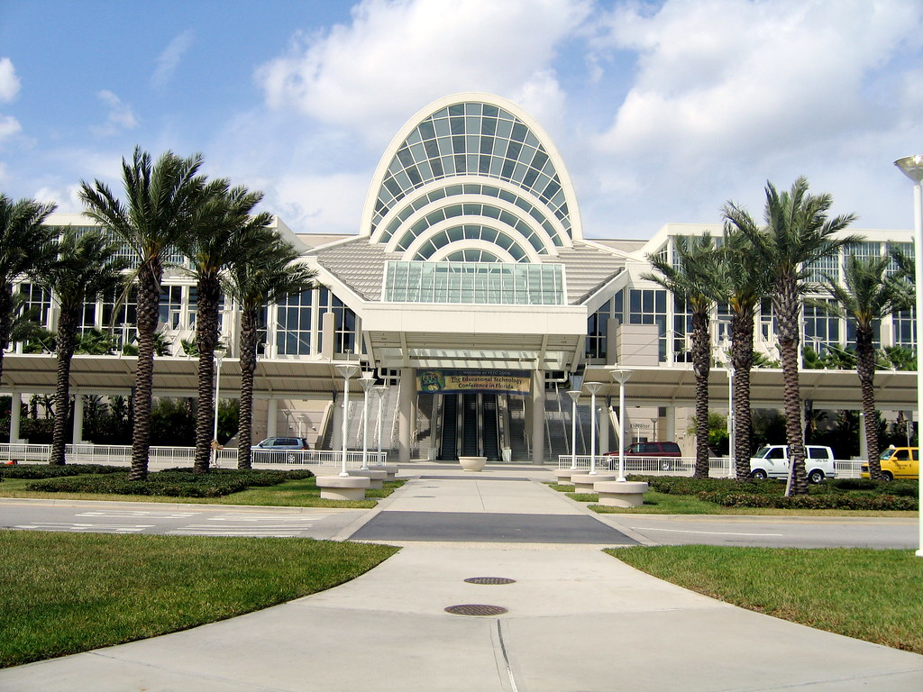
§200.432 Conferences.
A conference is defined as a meeting, retreat, seminar, symposium, workshop or event whose primary purpose is the dissemination of technical information beyond the non-Federal entity and is necessary and reasonable for successful performance under the Federal award. Allowable conference costs paid by the non-Federal entity as a sponsor or host of the conference may include rental of facilities, speakers' fees, costs of meals and refreshments, local transportation, and other items incidental to such conferences unless further restricted by the terms and conditions of the Federal award.

Slide 23
Fund Raising for Endowments
§200.442 Fund raising and investment management costs.
(a) Costs of organized fund raising, including financial campaigns, endowment drives, solicitation of gifts and bequests, and similar expenses incurred to raise capital or obtain contributions are unallowable. Fund raising costs for the purposes of meeting the Federal program objectives are allowable with prior written approval from the Federal awarding agency.

Slide 24
Grantee Handbook

Slide 25
25

Slide 26
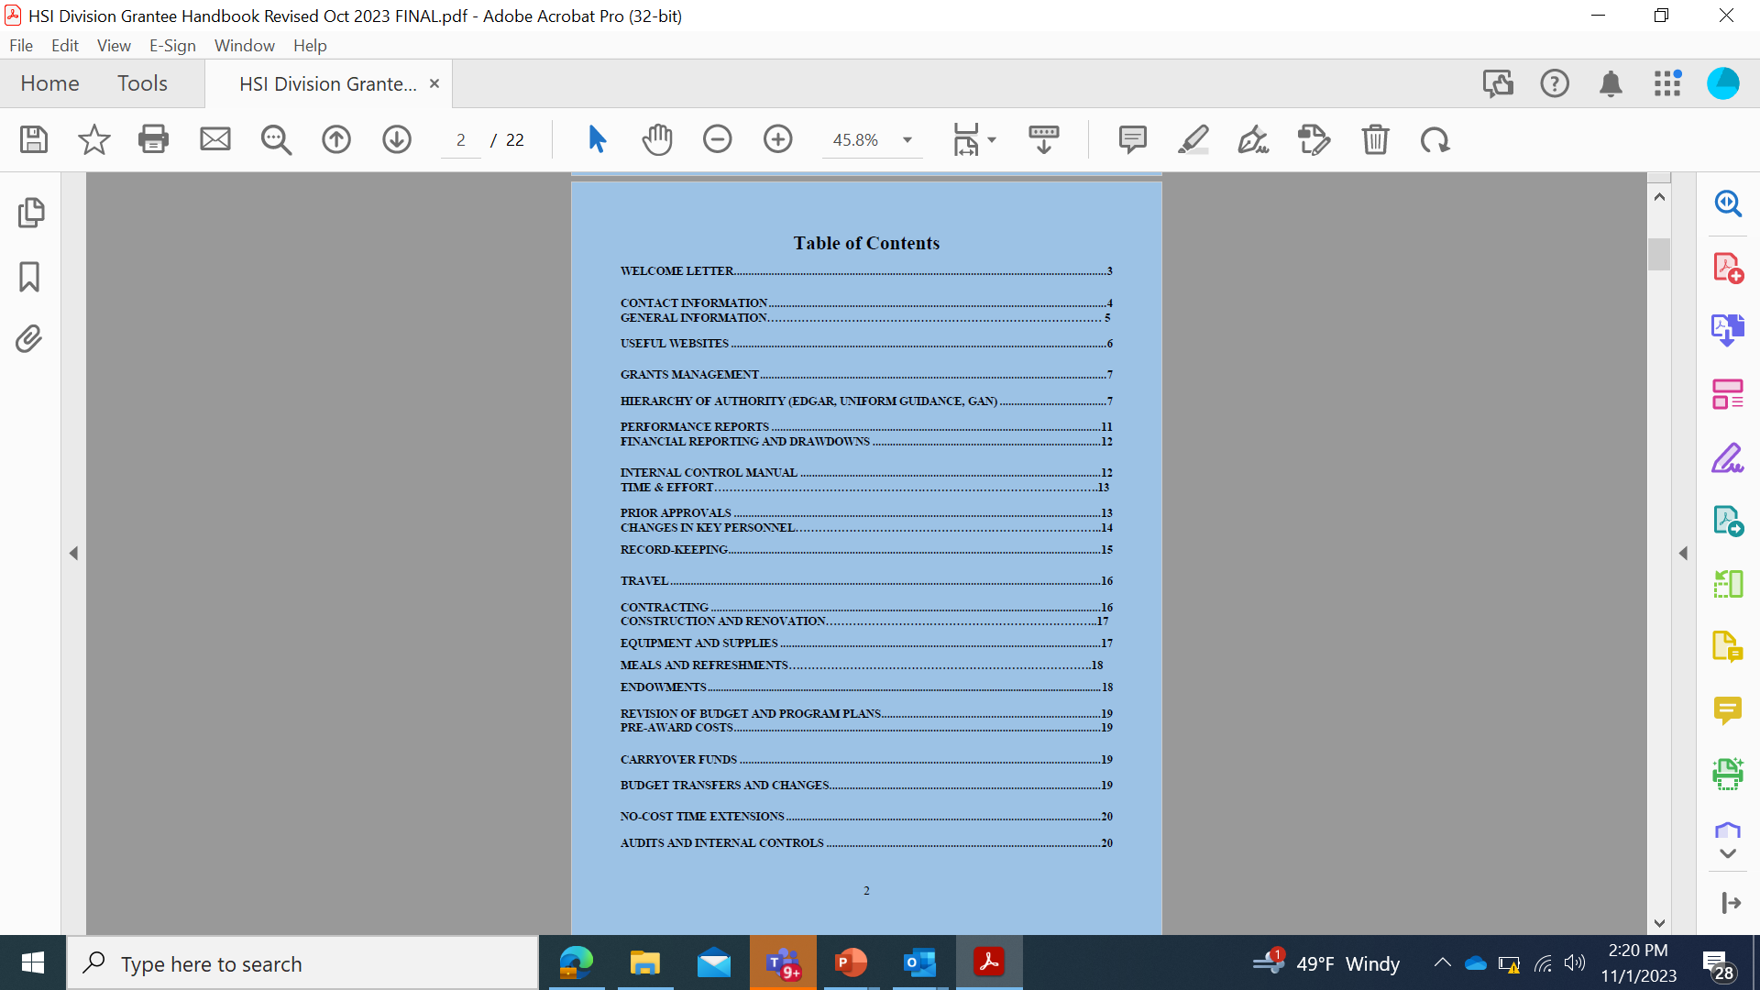
Grantee Handbook Table of Contents

Slide 27
Program Website
Developing Hispanic-Serving Institutions Program - Title V (ed.gov)

Slide 28
HSI Division Website

Slide 29
HSI Division Website –Performance Page

Slide 30
HSI Division website continued

Slide 31
Grant Award Notification (GAN) Attachments
Registration of DUNS Number in SAM
System for Award Management (SAM) Requirements
Memorandum Regarding the Use of Grant Funds for Meetings and Conferences
Responsibilities Associated with Managing Federal Funds
Financial Management System Requirements
Cash Drawdowns from the G5 Grants System
The G5 Payment Module
Financial and Performance Reports
Overview of Single Audit Requirements
Approval of Program Income
Trafficking in Persons
Reporting Prime Awardee Executive Compensation Data
Specific Conditions for Disclosing Federal Funding in Public Announcements
Prohibition of Text Messaging and Emailing While Driving During Official Federal Grant Business

Slide 32
HSI Division Newsletter
Sign up for the HSI Division Newsletter.

Slide 33
Online Grantee Training
Webinars can be found on the DHSI Website
There’s a grantee training portal on the Department’s website. (Uniform Guidance Page)

Slide 34
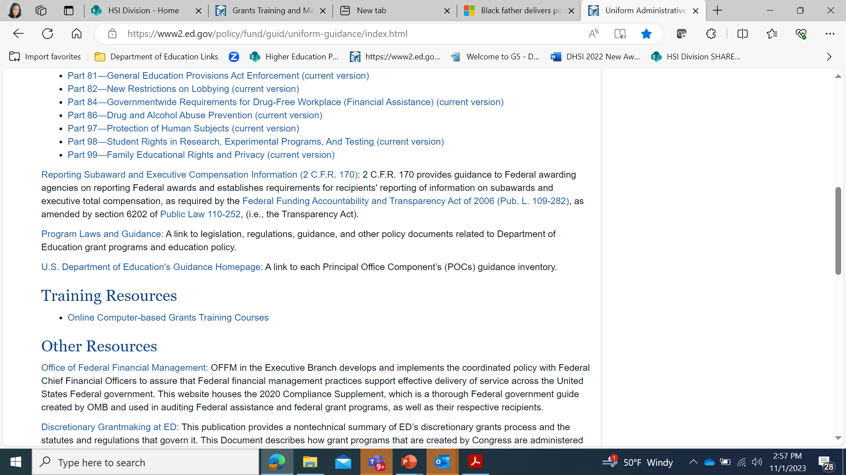
Training Resources

Slide 35
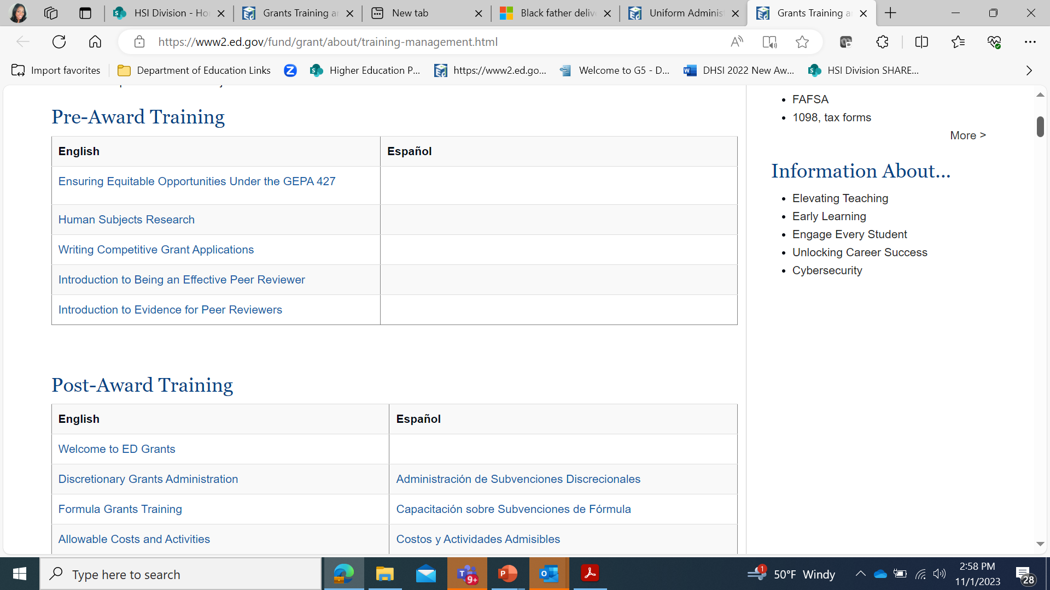
Training Resources

Slide 36
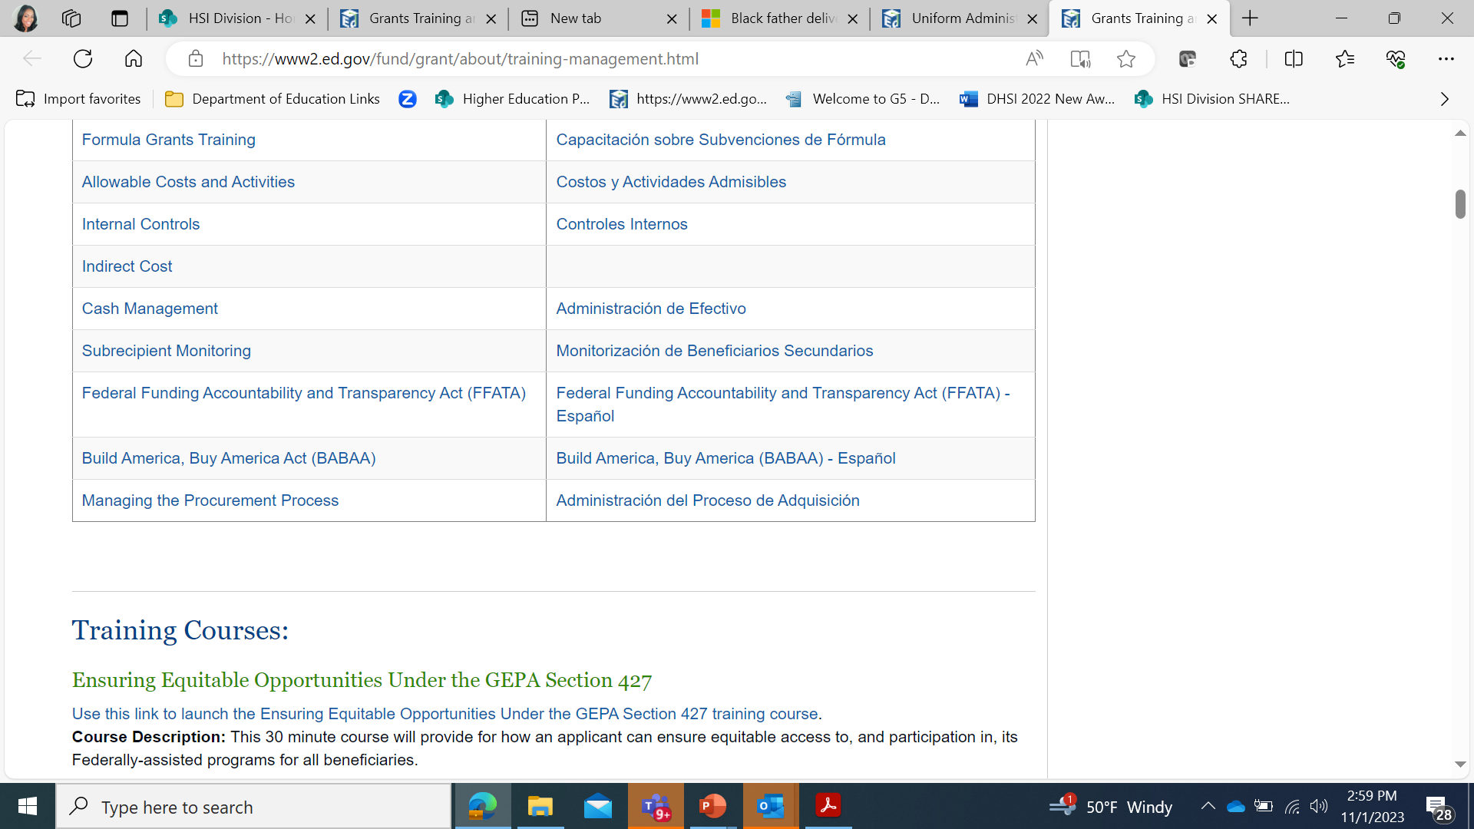
Training Resources

Slide 37
Challenges for
Project Directors
Delays in implementation
The new virtual environment
Communication and Clarifying expectations within the team and/or other departments
Lack of buy-in from the administration
Sustainability/institutionalization
Increased probability of flaws in the project design if application was not written in-house
Lack of understanding of grant policies/Dept. of ED policies and regs
Poor management of the grant project
Changes to budget, implementation plan, etc.

Slide 38
What are some of the challenges you have experienced?

Slide 39
Other considerations for the Project Director…

Slide 40
Does the grant have its own Internal Controls Manual or SOP document?

Slide 41
Internal Controls Manual (SOPs) for Federal Grant P031S19XXXX U.S. Department of Education Table of Contents
SAMPLE
PROJECT ABSTRACT………………………………………..……..1
ORGANIZATION AND PERSONNEL……………………………………...…….2
DIRECTORY OF PERSONNEL………………….....4
DHSI PROGRAM REGULATIONS AND UNIFORM GUIDANCE……………………………….5
DEPT. OF EDUCATION PERFORMANCE REPORTS………………………………………………..6
JOB DESCRIPTIONS
-Associate Program Manager…….…………………………….………7
-Activity Director ……………………..………….…………….....…..9
-Administrative Assistant……………….………………….……....14
-Project. Director……………………………………….......19
-Technology/Web Assistant………………………………............24
-Studio Classroom Specialist....………………….………………….29
-Systems Research Analyst ……………..…34
Monthly Progress Report…………………………….……………...42
Staff Time & Effort Report ……….…………44
Title V Undergraduate Time & Effort Report………………………………………..…...45
Peer Mentor Time & Effort Report………………………………..……………46
HIRING PROCESS ………………………………….………..47
Faculty ………………………………………………..47
Students…………………………….………………….48
Personnel Status Form ……………………………..50
Student Employment Form……………………....51
W-4 Form...………………………………………….…………52
I-9 Form………………………………………………………...53
PROCEDURES FOR EXPENDITURES ………….……….55
Purchase Requisitions ………………………….....58
Check Requests ……………… ……….……………59
Check Request Form ……………………………….60
Purchase Order Form ………………………………61
EQUIPMENT MANAGEMENT……………………………………….………..62
Equipment Inventory Form ……………………...63
Equipment Inventory Record ………………….…64
TRAVEL REGULATION AND POLICY………………......65
Travel Request /Reimbursement Form ………66
STIPENDS………………………………………………..….....67
Stipend Request Form…………………………………...…68
W-9 Form ……………………………………………………....69

Slide 42
Equipment is defined as an item that has a cost ≥ $5000.00 and has a useful life of more than one year. Please include computers, laptops, tablets, printers, etc. as equipment although the per unit cost may be less than $5000.00 2 CFR Part 200.313
How do you manage your equipment?

Slide 43
Publications and Press Releases
PUBLICATIONS
Grantees, in carrying out their grants, may
Grantees, in carrying out their grants, may plan to publish a variety of materials. If producing materials as part of grant activities, grantee must include in any such materials the disclaimer in EDGAR §75.620 that states:
The contents of this (insert type of publication; such as book, report, film) were developed under a grant from the U.S. Department of Education. However, those contents do not necessarily represent the policy of the Department of Education, and you should not assume endorsement by the Federal Government.
PRESS RELEASES
When issuing statements, press releases, requests for proposals, bid solicitations and other documents describing projects or programs funded in whole or in part with Federal money, U. S. Department of shall clearly state:
The percentage of the total costs of the program or project which will be financed with Federal money;
The dollar amount of Federal funds for the project or program; and
The percentage and dollar amount of the total costs of the project or program that will be financed by non-governmental sources.

Slide 44
At the end of your Performance Period
Closing out your grant
Project Director will receive a close out notification letter on October 1.
90-day Liquidation period-usually Oct.1-Dec. 31
Grantee may continue to draw down for liquidating obligations during the 90-day period immediately following the project end date. Grantee may not incur any new obligations during the 90-day liquidation period.
Final Performance Report due at next cycle
Title to equipment and supplies acquired by a recipient with Federal funds shall vest with the recipient.
Financial records, supporting documents, statistical records, and all other records pertinent to award shall be retained for a period of three (3) years from the date of submission of the Final Performance report.
If you have endowment activities under this grant award, you must continue to submit annual financial reports to the Department for a time period after the grant has ended.

Slide 45
Frequently Asked Questions
1. Do we need approval to modify our budget? If budget changes are 10% or more of your annual budget, you DO need approval from your ED PS to make the modification. Also, when you move money from training, you need prior approval.
2. Do we have to implement the activities as proposed in the application? We want you to adhere to the fidelity of the proposal, but if changes need to be made, contact your ED Program Officer.
3. What if we can’t find staff to fill all the positions included in the application? Contact your ED PO for recommendations. He or she will work with you to modify your activities, budget, etc.
4. Can I serve as the Certifying Official and Project Director? No. There must be checks and balances.
5. How long do I have to hire a Project Director? There must be an interim PD put in place immediately. If you do not hire a PD in 90 days, you may be deemed a high-risk grantee which has implications.
6. Can the Dean of Academic Affairs serve as Project Director and be paid from the grant? The Dean cannot be paid from the grant since he has college-wide administrative authority, but he or she can serve with “0.00” salary on the budget chart.
7. Are indirect costs allowed? No
8. Can we pay for student stipends? Yes, as long as the expense connects to the grant objective.
9. Can we pay for student travel? Yes, as long as the expense connects to the grant objective.
10. Can we pay for international travel for faculty to attend a conference? Yes, as long as the expense connects to the grant objective.
11. Can we give students gift cards? Yes, as long as the expense connects to the grant objective.
12. What happens if we lose our HSI status during the performance period? Our practice has been that the grantee retains eligibility for the entire performance period.

Slide 46
Helpful Tips
Use your resources!
Include the PR Award number on all emails and correspondence.
When in doubt, ask your PS.
Do not work in a silo. Be sure your team as well as other departments and leadership know about your project and the great work you are doing.
Work closely with your evaluator.
Attend meetings, conferences, and other grant related events.
Share your accomplishments with the Department.

Slide 47
Important Dates and Information
Visit www.ed.gov/hsi regularly
for updates and news.

Slide 48
Thank you

